Slide 1

Unmanned marine life quality monitoring device
Project By: Mujeeb, Hamidreza, Hesam

Slide 2
The problem
Monitoring a tiny sample of water only.
Why not monitor water quality from a broader area and then take average for an even accurate reading?

Slide 3
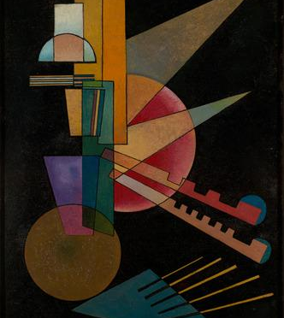
The solution
IoT will add efficiency, speed and accuracy to the system.
Manual procedure is tiresome, prone to errors and time taking.

Slide 4
Connected Components
Following are the sensors/components connected with the STM32 board
STM32 board
Capacitive sensor
DHT11 or 22
IR sensor
Capacitive sensor and
Grove sunlight sensor
A servo motor
A relay

Slide 5
Data Collected
All the data coming from sensors is expected to be numerical data that can be stored in a .CSV or .json file or in a database like sqlite.

Slide 6
Collective Intelligence, things to learn, effect of actions of actuators, overall effectiveness
All the data combined will give us ability to analyse the water sample. We expect our algorithm to combine all data, analyse it, calculate average, reduce uncertainty and produce correct results.
We'll learn data processing, factors that can affect our calculations, moving data from MCU to cloud for storage to showing it to the user in dashboard. We won't act. We'll just leave the device setting the parameters, that's it.
We're just moving a device in water. It has no effect on anything. When it comes to effectiveness of sensors, I'm not sure about how their readings will be effective or if we would have to take multiple readings and then average them out to get the right one.

Slide 7
Power Source
Constraints
Internet Connectivity/communication
Water insulation research

Slide 8
Async Programming/Threading
Plan and metrics
Less thread switching
Choice of algorithm, data-structure and programming language
Have a device with a rechargeable power resource, plus always have an active working internet connection and it should be less prone to failure especially the sensors.

